Slide 1
Requirements Presentation
Stock Predictions
By the Baby Bezoses
Groups Members: Sean Tierney, Henry Green, Luke Bushur
Notes:
Luke

Slide 2

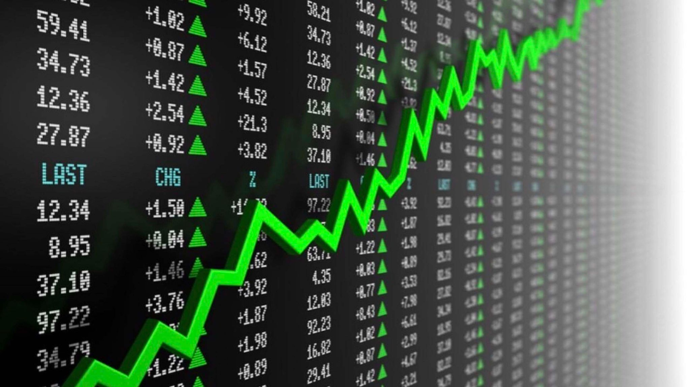
Project Overview
MLM capable of learning based on stock data & currency exchange rates.
Online learning: Data is fed to the model incrementally over time.
Web application generates a recommendation based on a given stock ticker.
Goal: Invest and make at least $0.25
Notes:
Henry

Slide 3


Must-Have Functional Requirements - MLM
Receive stock & currency exchange rate data with a diverse range of features.
Constantly process new stock & exchange rate data, updating the model.
Predict the closing price of a stock after being given relevant information.
E.g., stock ticker, date
Updated with new data each day & stores the previous model after each training step.
Developed using some type of deep learning technique.
E.g., long short-term memory, convolutional, recurrent
Notes:
Sean

Slide 4
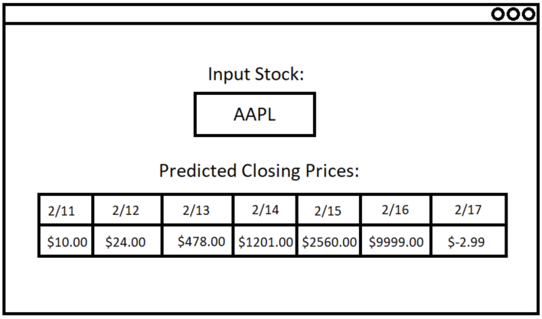
Must-Have Functional Requirements - Web Application
MLM hosted on the backend
Backend interfaces with MLM to prompt it to generate predictions
Front-end
Form to input a stock name/ticker
Webpage outputs the predicted closing prices
Technology
Python Flask - Full-stack framework
Notes:
Luke

Slide 5
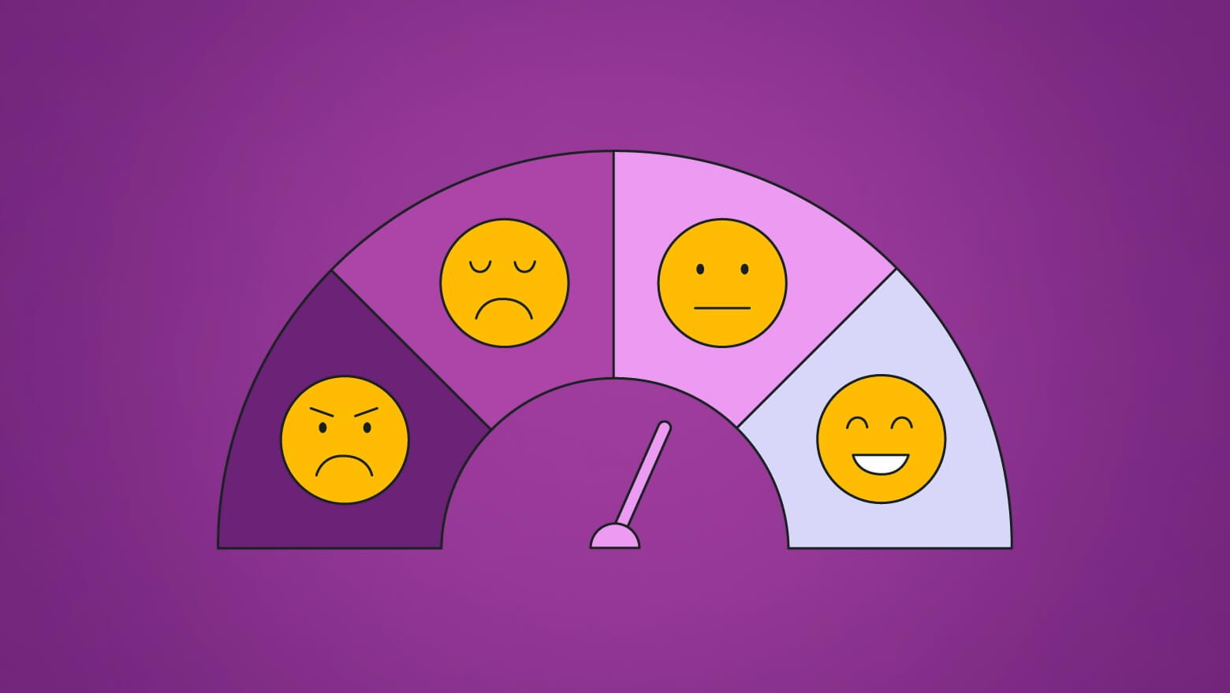
Optional Functional Requirements
When users enter a stock ticker, a chart of the stock’s performance appears
The model can give the predicted high, low, and opening values for a particular day/time period
Usage of sentiment analysis for additional recommendations.
E.g., search for what people think about the stock online and recommend either buying or selling the stock.
Notes:
Sean

Slide 6
Must-Have Non-Functional Requirements
Optional Non-Functional Requirements
The response of the machine learning model should be reasonable.
The web application should be easy for users to use/navigate.
Simple, intuitive design
Any data should be stored securely.
The MLM should give good financial advice. In other words, it should make a profit.
The model and application should only be accessible by authorized sources.
Exclude attackers, spammers, bots, etc.
Notes:
Henry

Slide 7

Thank you! Any Questions?
Notes:
Jason

